Slide 1
Demo UI
Eksempel til demo

Slide 2
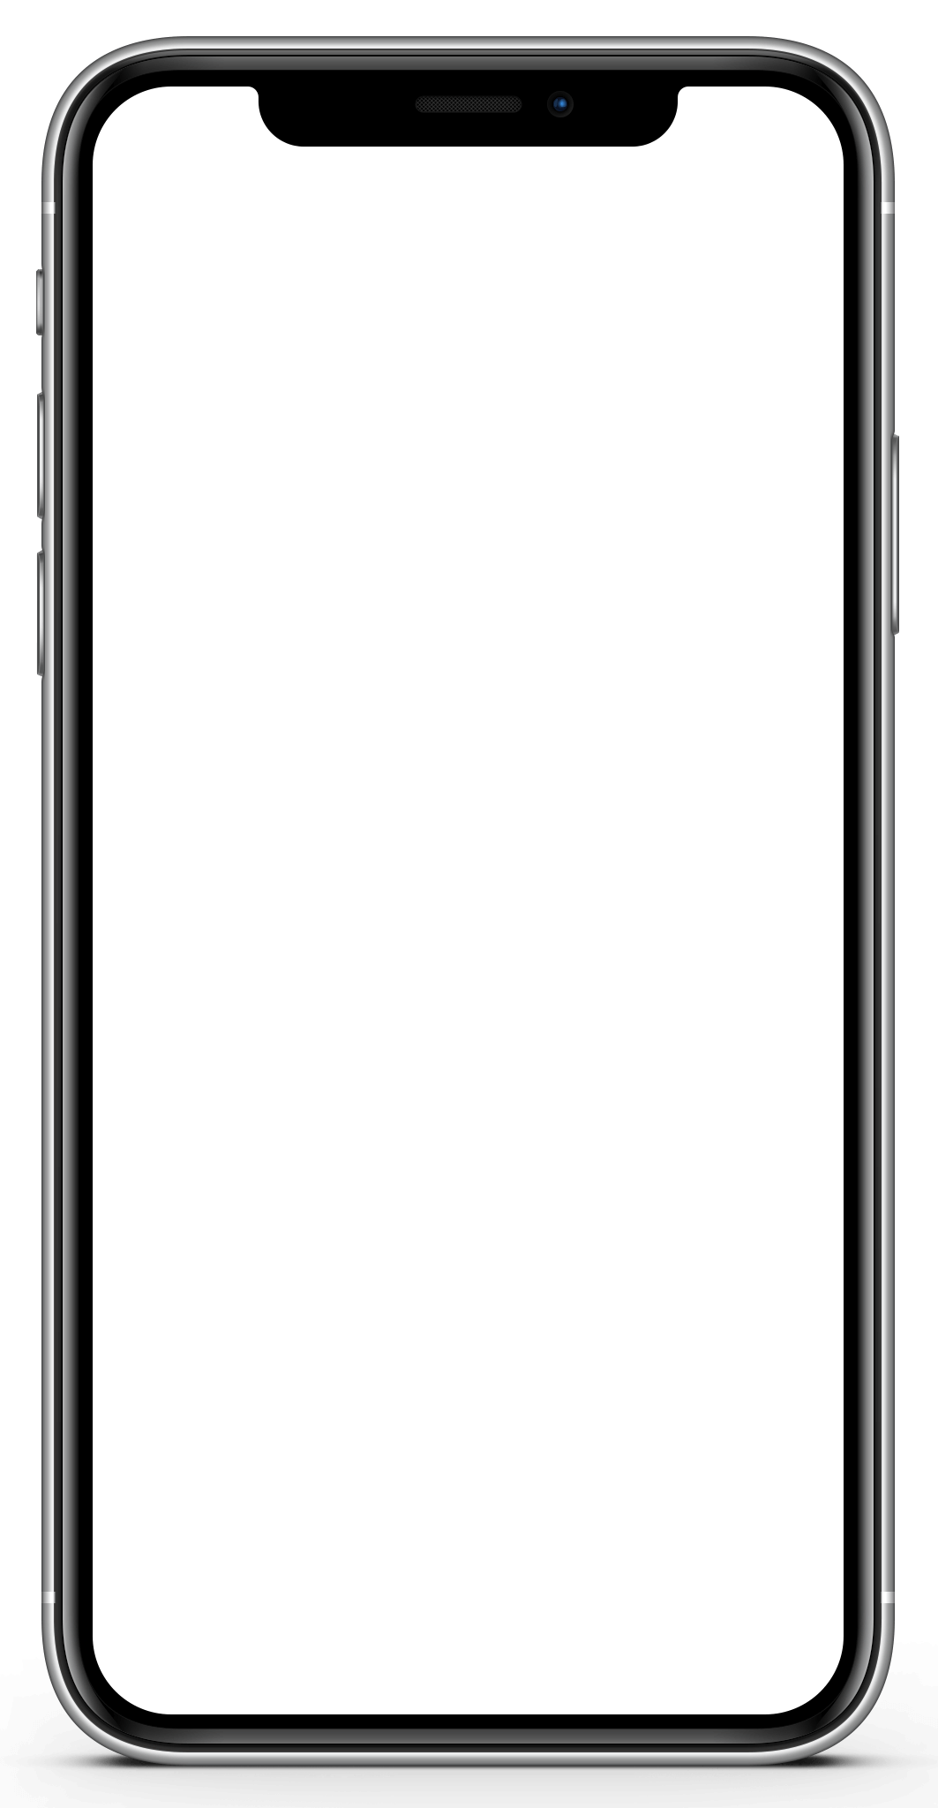
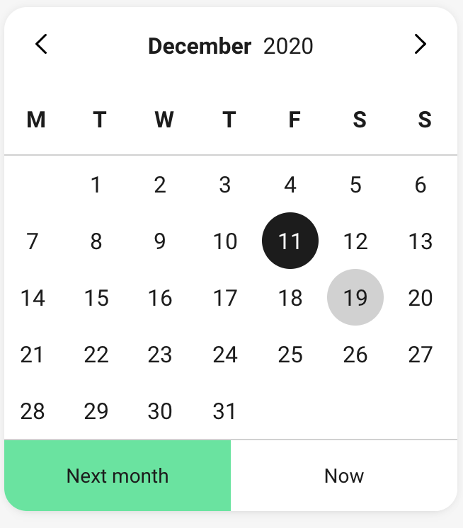
Betaling af regning
Velkommen
Betal regning
Betaling registret
Fra
konto
Fra
Konto | Budget konto
Beløb | 5000 kr.
Til
korttype | 01
Kreditor | xx99x9x
Betalings-ID | xx99xxx999
Betalingsdato | 12-12-2021
Dette er vores starter eksempel
Lirum larum ……..
Beløb
Betal regning
?kr.
Til
Korttype
01
04
15
71
73
75
Evt.
med Kirby calender kontrol
Betalings-ID
Kreditor
Betalingsdato
Dd-mm-år
Tilbage til forside
Betal

Slide 3
Cheat sheets

Slide 4
Cheat sheet: Referencer
Fundamentals
Ionic
Kirby
Angular IO Dokumentation
Dokumentation og get started
https://angular.io/docs
Ionic Dokumentation
Introduktion og dokumentation til Ionic
https://ionicframework.com/docs
Kirby Get Started
Guideline til opsætning af udviklingsmiljø
https://github.com/laljyskebank/kirby-simple-starter/blob/master/Kom%20i%20gang%20med%20Kirby.docx
Tutorials HTML, CSS, JavaScript
Standard tutorials
https://www.w3schools.com
Ionic Get Started
Hvis du vil bygge en Ionic App
https://ionicframework.com/docs/developing/starting
Kirby Starter Template
Starter template til Kirby, Ionic og Angular
https://github.com/laljyskebank/kirby-simple-starter
Type Script Docs
Dokumentation, guidelines, begynder guides
https://www.typescriptlang.org/docs
Ionic Komponenter
Komponenter til Ionic, kan også bruges i Kirby starter
https://ionicframework.com/docs/components
Kirby Design System
Kirby startside
https://kirby.design
CSS reference
https://devdocs.io/css/
https://www.w3schools.com/cssref
Ionic Commands
Ionic CLI Commands: build, serve, start generate, etc.
https://ionicframework.com/docs/cli
Kirby Komponenter
Alle Kirby komponenter
https://cookbook.kirby.design/home/intro
NG Commands
Angular CLI Commands: build, serve, start generate, etc.
https://angular.io/cli
GitHub Get Started
https://docs.github.com/en/free-pro-team@latest/github/getting-started-with-github

Slide 5
Cheat sheet Angular: med udgangspunkt i betalingsdemo
Routing
App-Routing.module.ts eller komponent routing module
https://angular.io/guide/router
Component Guide
Generelt komponent guide
https://angular.io/tutorial/toh-pt3
Angular Architecture
Angular arkitektur overblik
https://angular.io/guide/architecture
To vejs databinding
Se eksempel i pay bill i demo. Eller Angular dok
https://angular.io/guide/two-way-binding
Kirby Komponenter
Alle Kirby komponenter
https://cookbook.kirby.design/home/intro

Slide 6
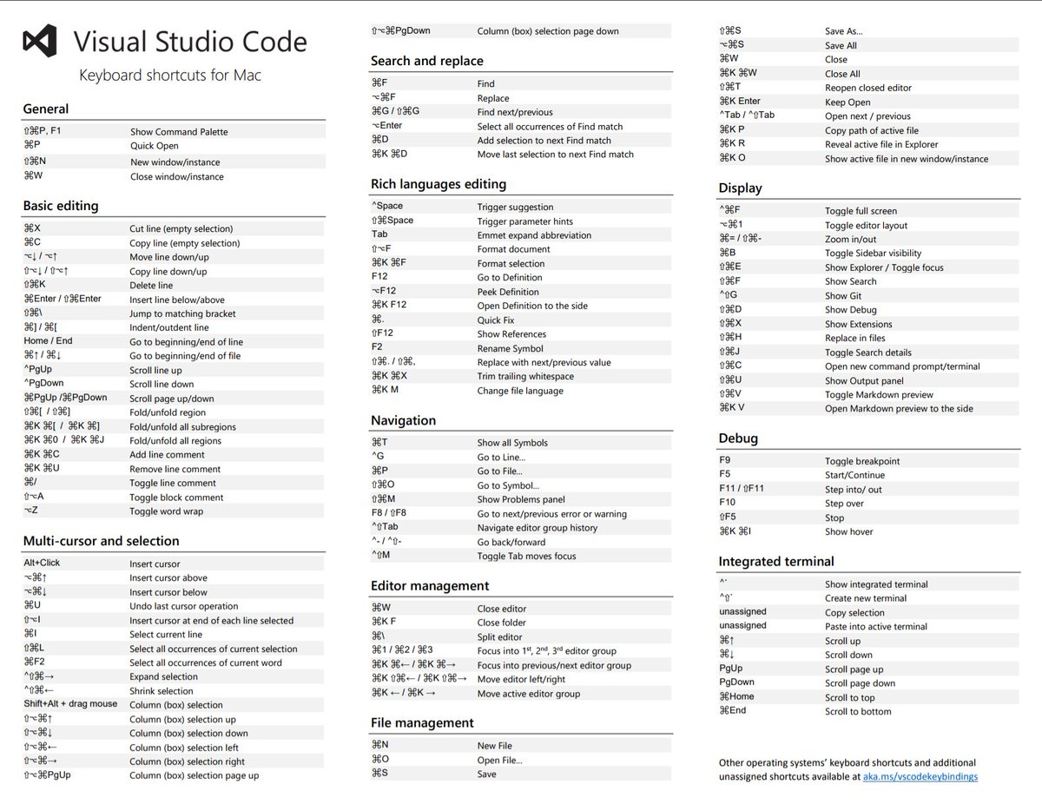

Slide 7
